Slide 1

MAJOR PROJECT (MCAN-482) PPT PRESENTATION ON CROP RECOMMENDATION SYSTEM SESSION: 2022-2024
PROJECT GUIDE:
Dr. Arnab Chakraborty
Team Members:
Siddhartha Khawas (10871022006)
Subham Chakraborty (10871022007)
Sumit Kumar Choubey (10871022003)
Shivendu Shivam (10871022051)

Slide 2
Acknowledgement
Project Objective & Scope
Data Description
Methodology
Data Preprocessing
Models Used
Accuracy Comparison
GUI snapshot
Future Scope of Improvements
Contents

Slide 3
ACKNOWLEDGEMENT
We extend our heartfelt gratitude to our project guide Dr. Arnab Chakraborty, for his invaluable guidance and unwavering support throughout our endeavor on the 'Crop Recommendation System.' His expert advice and constant encouragement were pivotal in helping us navigate the challenges of this project. We are immensely thankful for his mentorship and the wealth of knowledge he shared with us.
Additionally, we would like to express our sincere appreciation to all the team members who dedicated their time, effort, and expertise to the success of this project. Each member's unique contributions played a crucial role in bringing our vision to fruition. Together, we overcame obstacles, collaborated effectively, and achieved our goals. Thank you for your unwavering commitment and teamwork.
Thank You all for your support.
SIDDHARTHA KHAWAS (10871022006)
SUBHAM CHAKRABORTY (10871022007)
SHIVENDU SHIVAM (10871022051)
SUMIT KUMAR CHOUBEY (10871022003)

Slide 4
Project objective & scope
Objective:
To develop an intelligent crop recommendation system that uses machine learning to analyse soil nutrients (Nitrogen, Phosphorus, Potassium), environmental data (Temperature, Humidity, Rainfall), and soil pH to advise farmers on the most suitable crops to cultivate for optimal yield.
Goal:
Create a robust predictive model that inputs Nitrogen, Phosphorus, Potassium, Temperature, Humidity, pH, and Rainfall to generate accurate and personalized crop recommendations, thus increasing agricultural efficiency and sustainability.
Scope:
It is a useful project as the classifier models can be used to quickly determine the suitable crop for the cultiave in the soli of the large dataset.

Slide 5
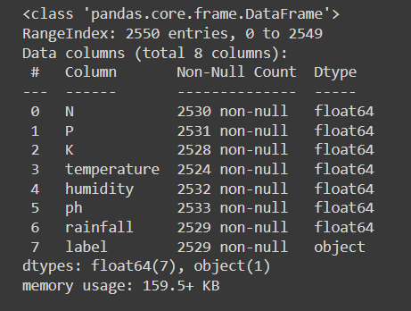
Data description
The description of the data with type and description of each Attribute is given/shown in the table.

Slide 6
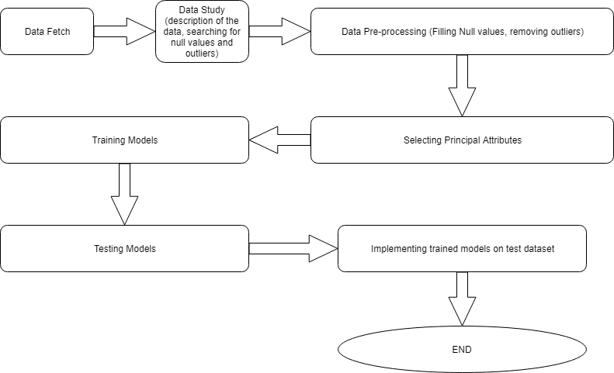
Methodology

Slide 7
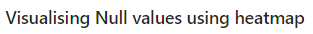
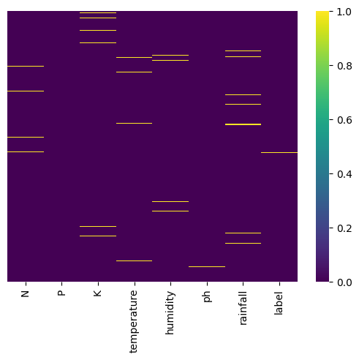
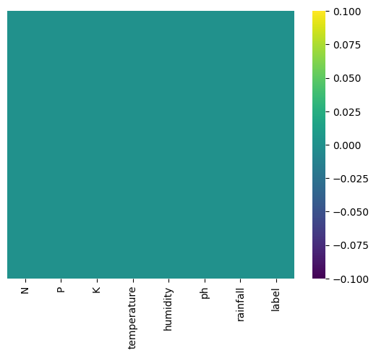
Data Preprocessing
Handling Null values
Before
After

Slide 8
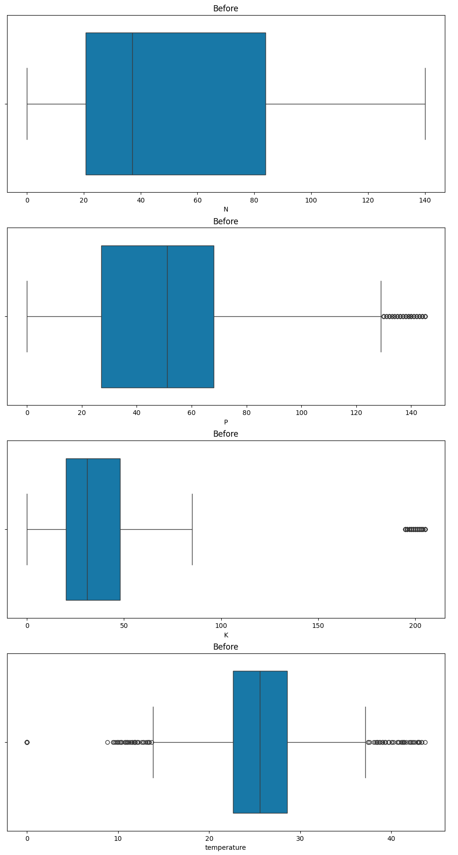
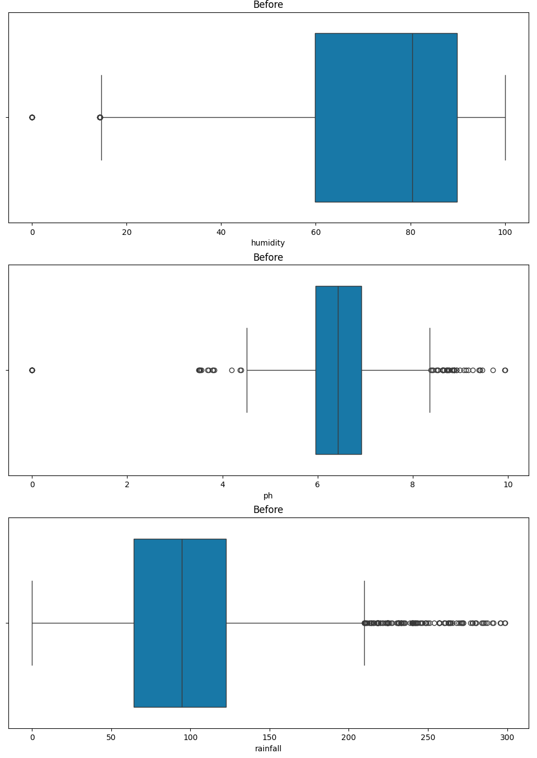
Outliers

Slide 9
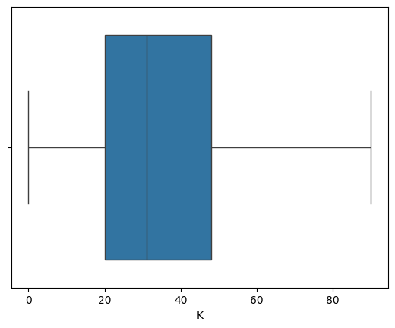
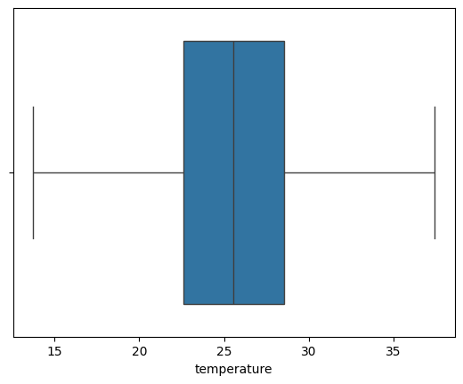
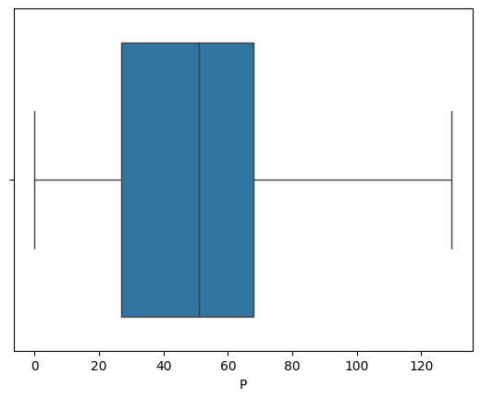
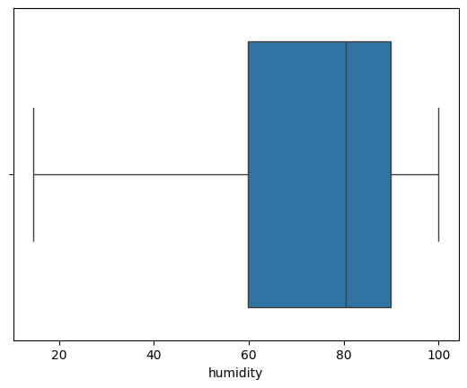
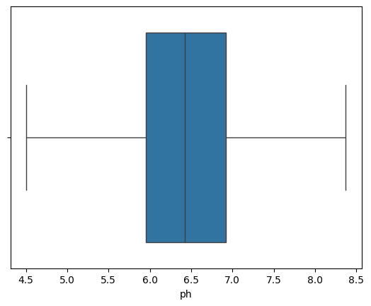
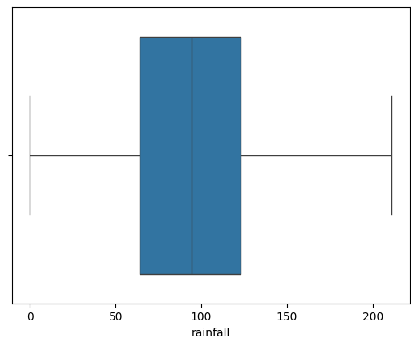
After removing the outliers

Slide 10
Models used
The Machine Learning models used for this project are:
Decision Tree
Logistic Regression
Random Forest
SVM Classifier

Slide 11
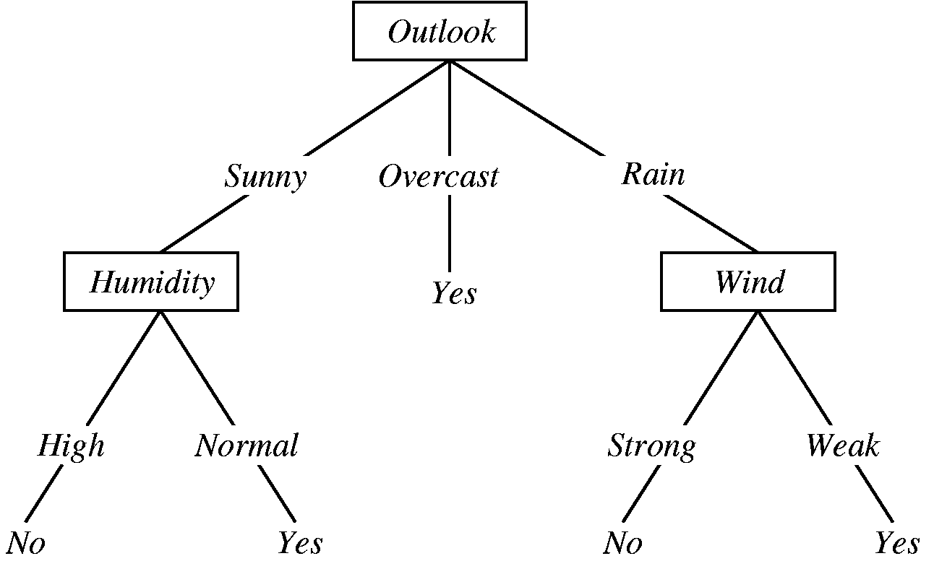
Decision tree
Decision Tree is a Supervised learning technique that can be used for both classification and Regression problems, but mostly it is preferred for solving Classification problems. It is a tree-structured classifier, where internal nodes represent the features of a dataset, branches represent the decision rules and each leaf node represents the outcome.
It is a graphical representation for getting all the possible solutions to a problem/decision based on given conditions.

Slide 12
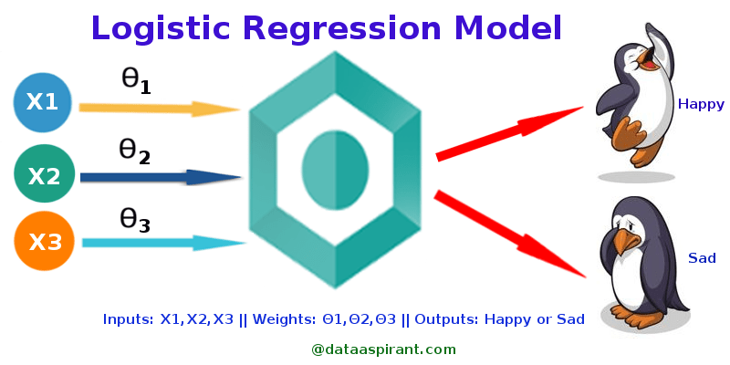
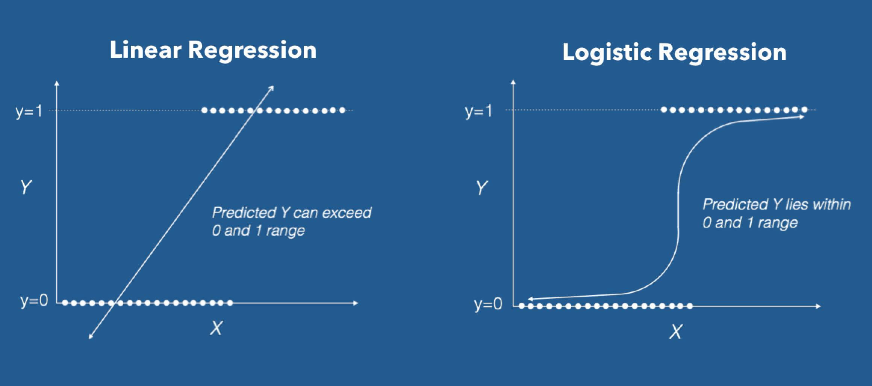
Logistic regression
Logistic regression is one of the most popular Machine Learning algorithms, which comes under the Supervised Learning technique. It is used for predicting the categorical dependent variable using a given set of independent variables.
Logistic regression predicts the output of a categorical dependent variable. Therefore the outcome must be a categorical or discrete value. It can be either Yes or No, 0 or 1, true or False, etc. but instead of giving the exact value as 0 and 1, it gives the probabilistic values which lie between 0 and 1.

Slide 13
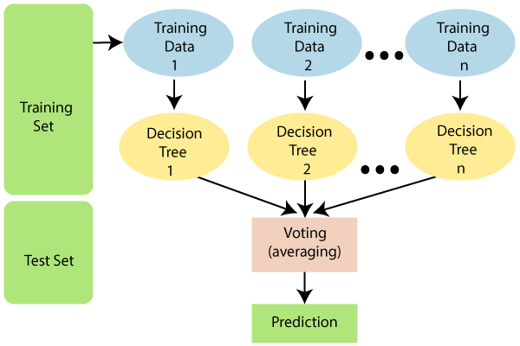
Random Forest
Random Forest is a classifier that contains a number of decision trees on various subsets of the given dataset and takes the average to improve the predictive accuracy of that dataset. Instead of relying on one decision tree, the random forest takes the prediction from each tree and based on the majority votes of predictions, and it predicts the final output.
The greater number of trees in the forest leads to higher accuracy and prevents the problem of overfitting.

Slide 14

Support Vector Machine Algorithm (SVM)
Support Vector Machine or SVM is one of the most popular Supervised Learning algorithms, which is used for Classification as well as Regression problems. However, primarily, it is used for Classification problems in Machine Learning.
The goal of the SVM algorithm is to create the best line or decision boundary that can segregate n-dimensional space into classes so that we can easily put the new data point in the correct category in the future. This best decision boundary is called a hyperplane.

Slide 15
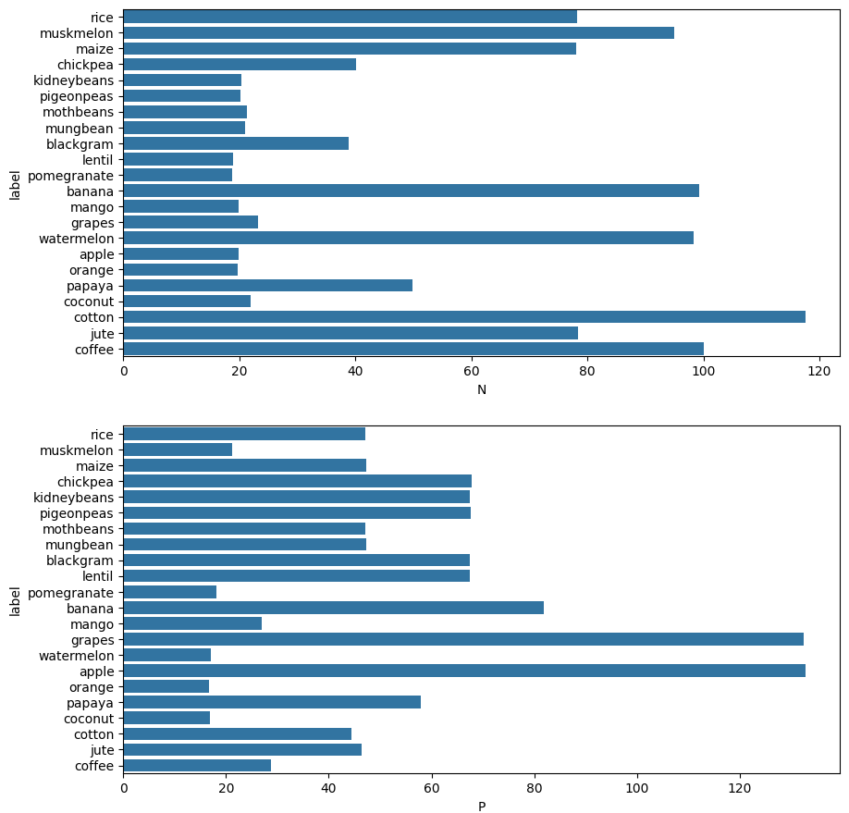
Visualising other attributes with respect to our target column i.e. 'Label'

Slide 16
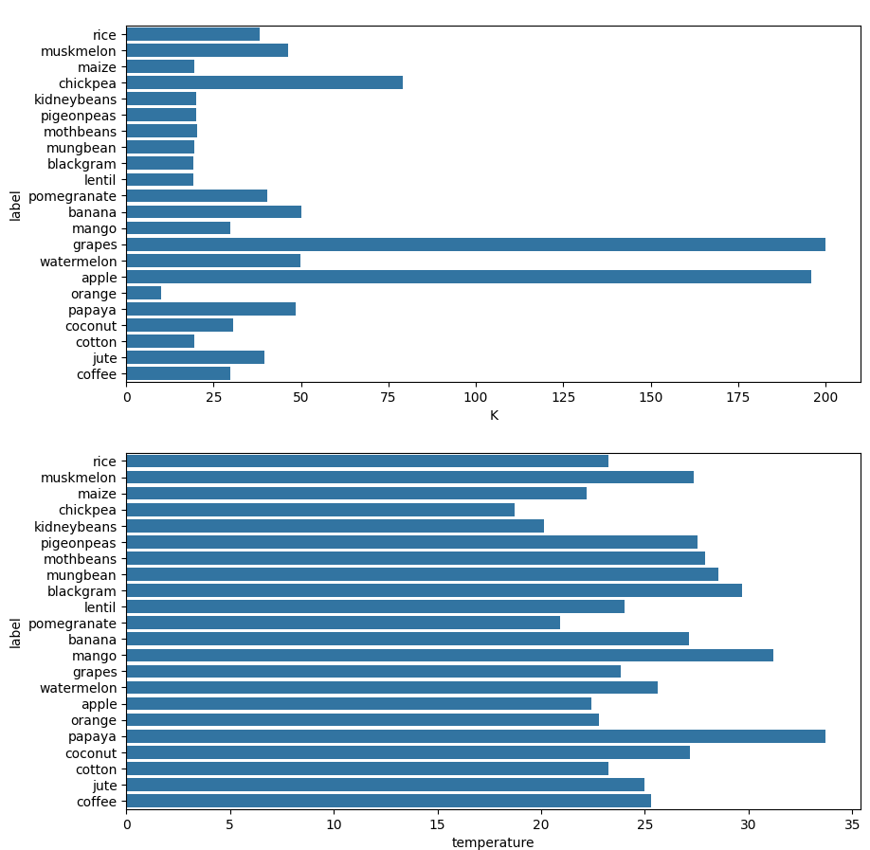

Slide 17
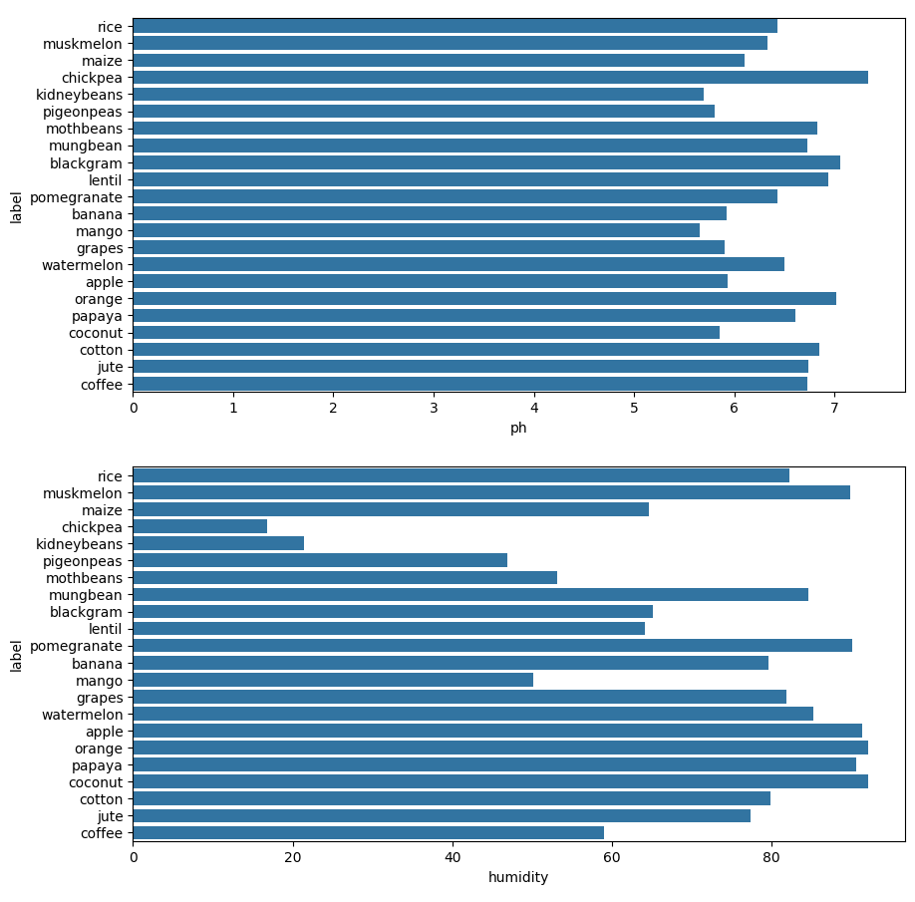

Slide 18
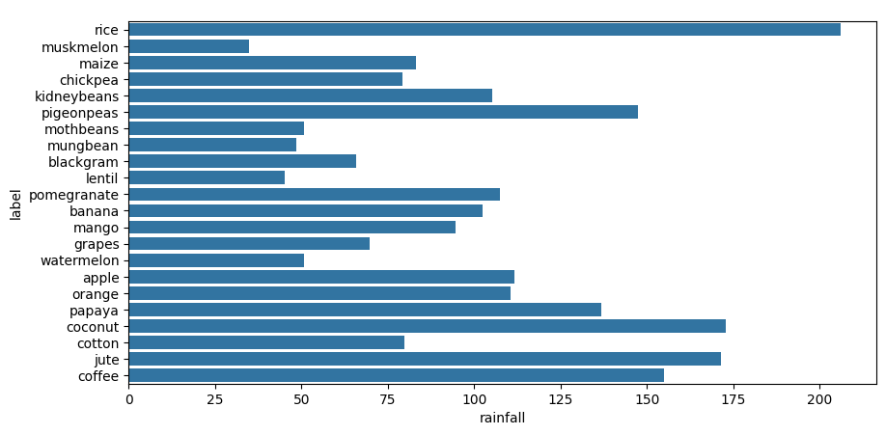

Slide 19
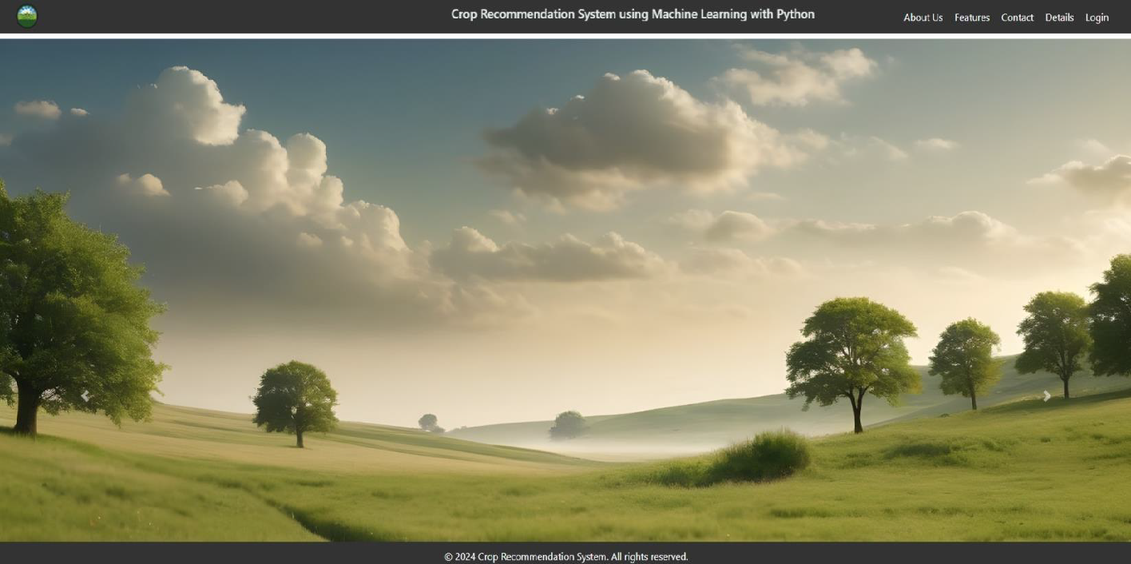
GUI Version of Crop Recommendation System
(index page)

Slide 20
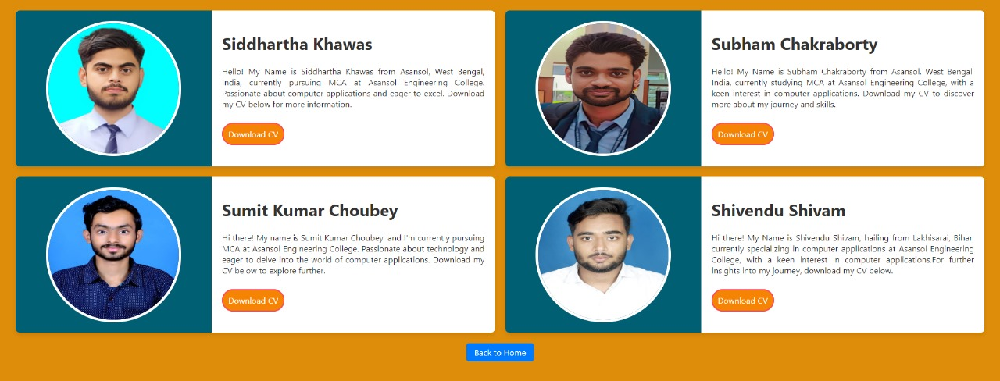
GUI Version of Crop Recommendation System (About us page)

Slide 21
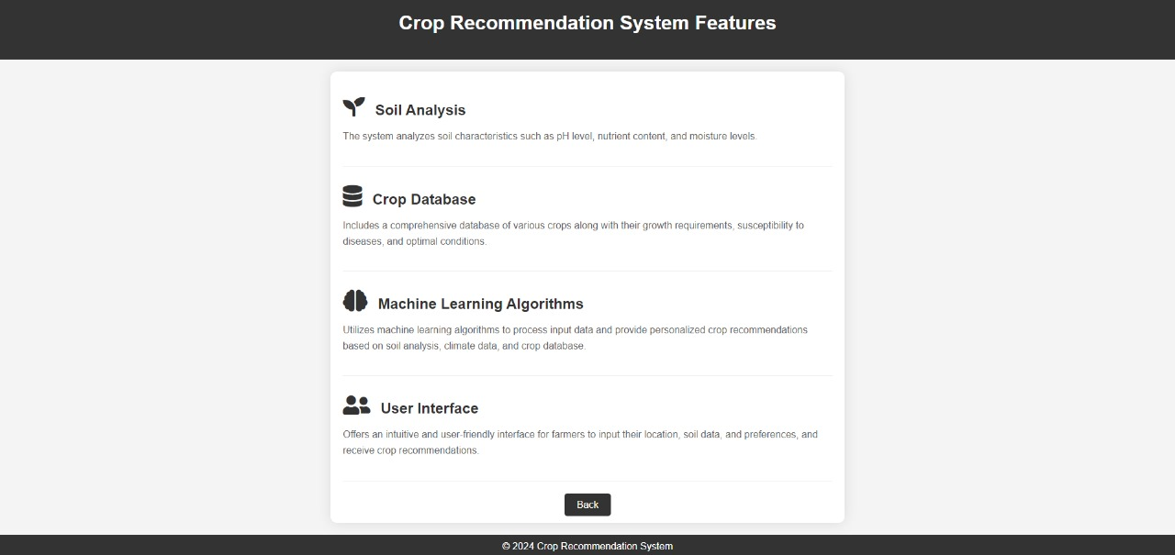
GUI Version of Crop Recommendation System (Features page)

Slide 22
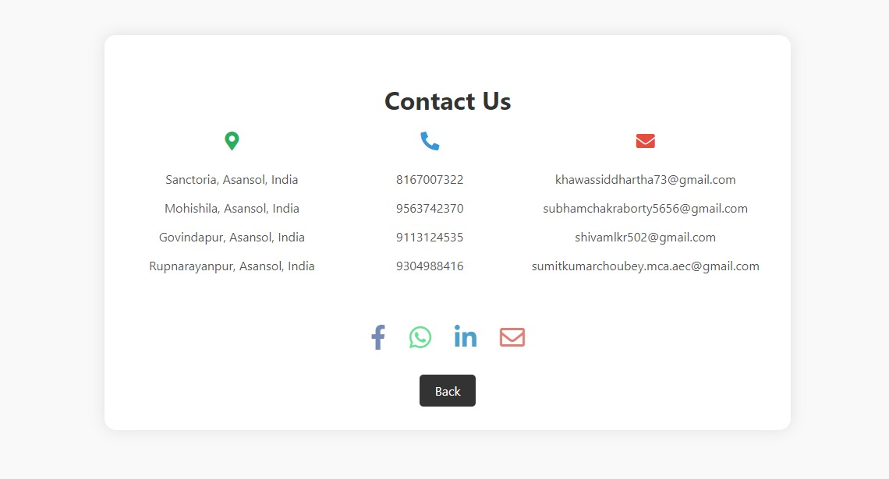
GUI Version of Crop Recommendation System (Contact page)

Slide 23
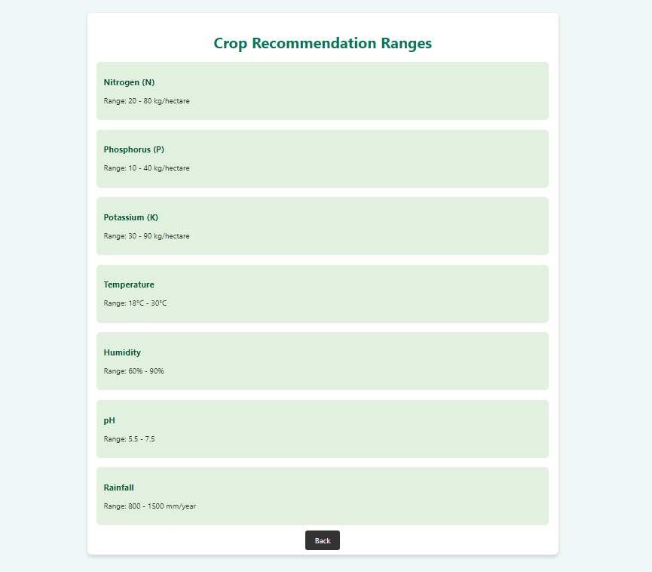
GUI Version of Crop Recommendation System (Details page)

Slide 24
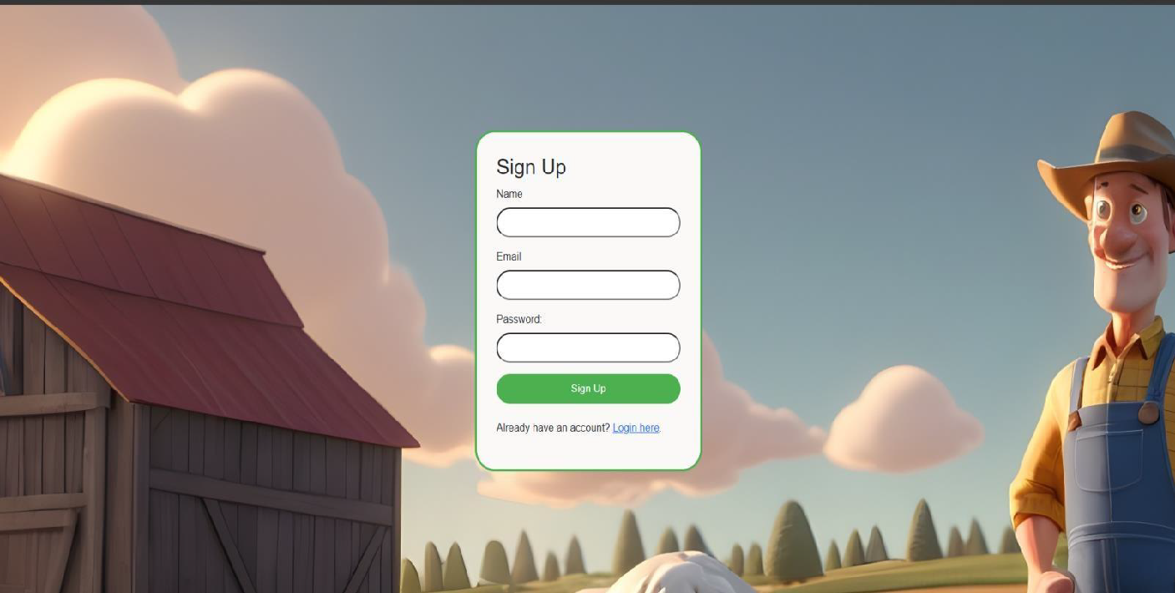
GUI Version of Crop Recommendation System (Signup page)

Slide 25
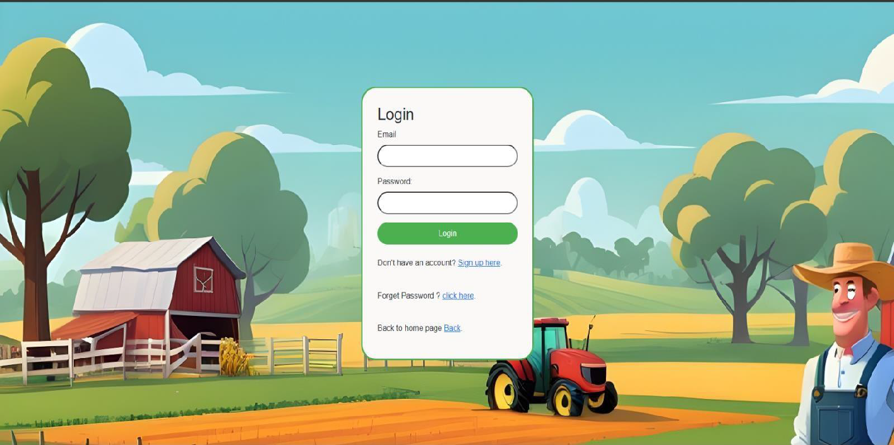
GUI Version of Crop Recommendation System (Login page)

Slide 26
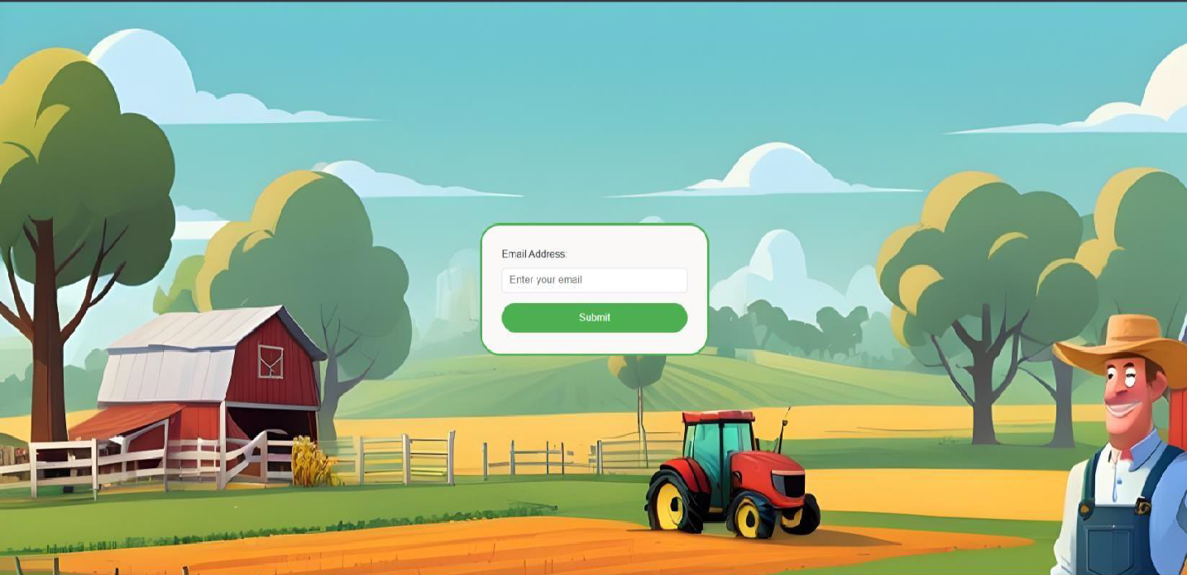
GUI Version of Crop Recommendation System (forgot your password page)

Slide 27
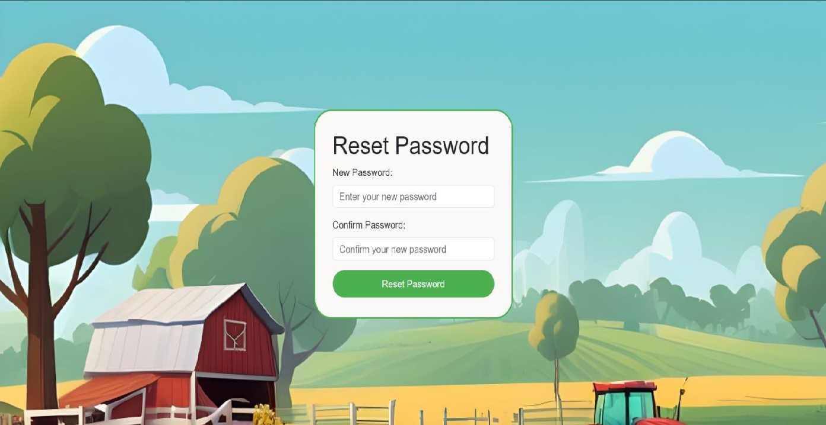
GUI Version of Crop Recommendation System (Reset page of your password )

Slide 28
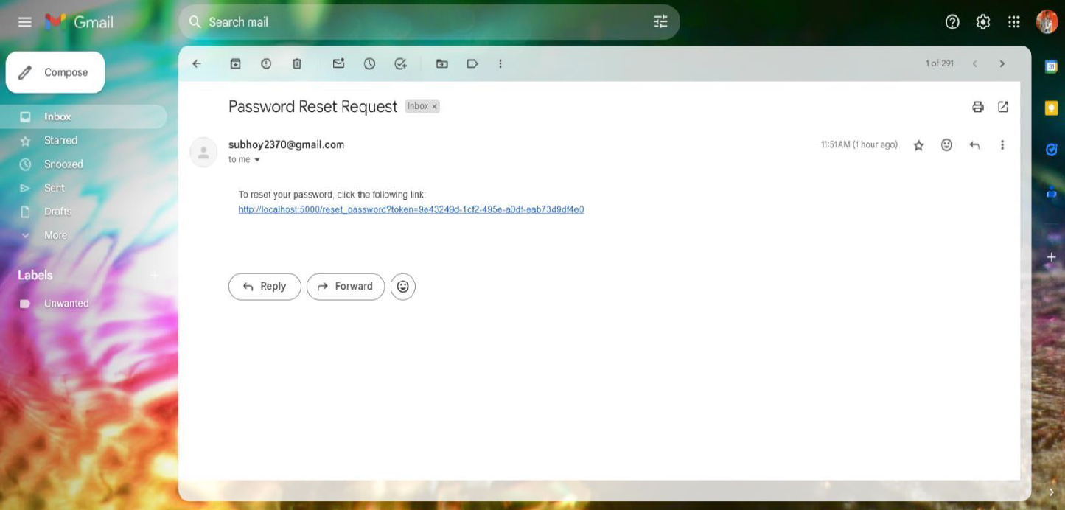
GUI Version of Crop Recommendation System (forgot password reset request mail send in your registered email id )

Slide 29
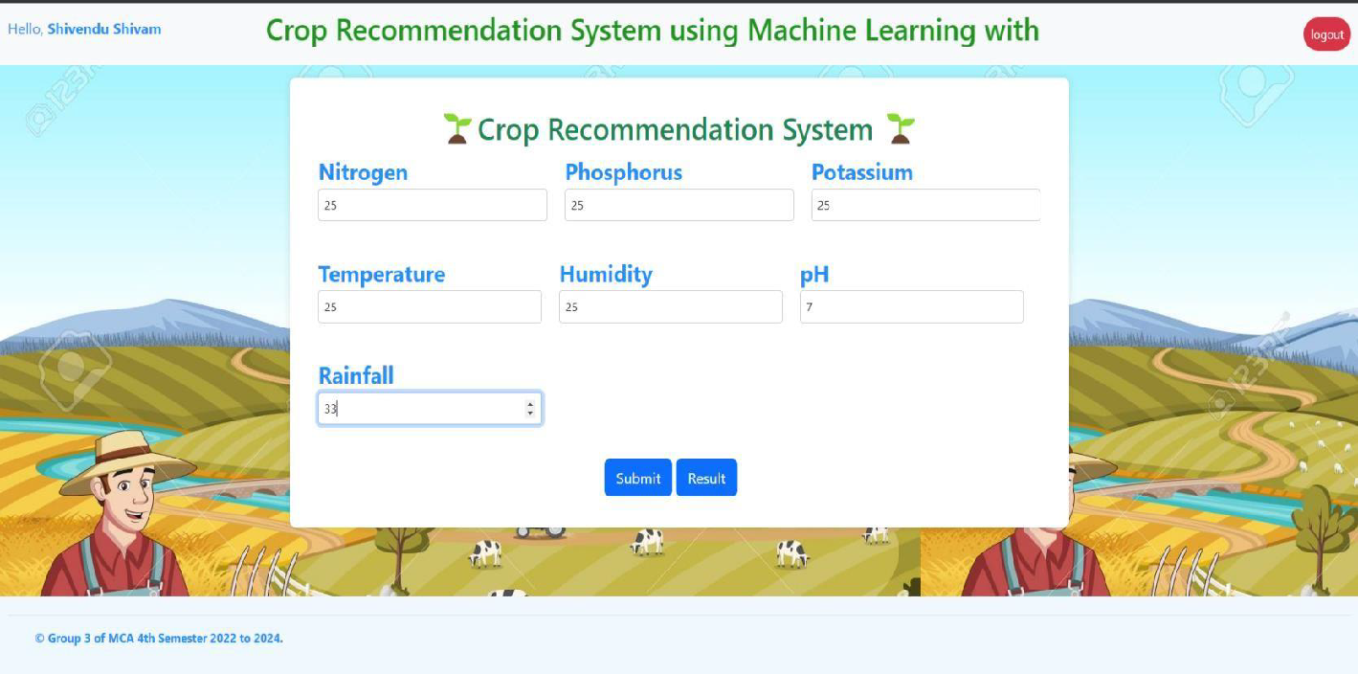
GUI Version of Crop Recommendation System (Main page)

Slide 30
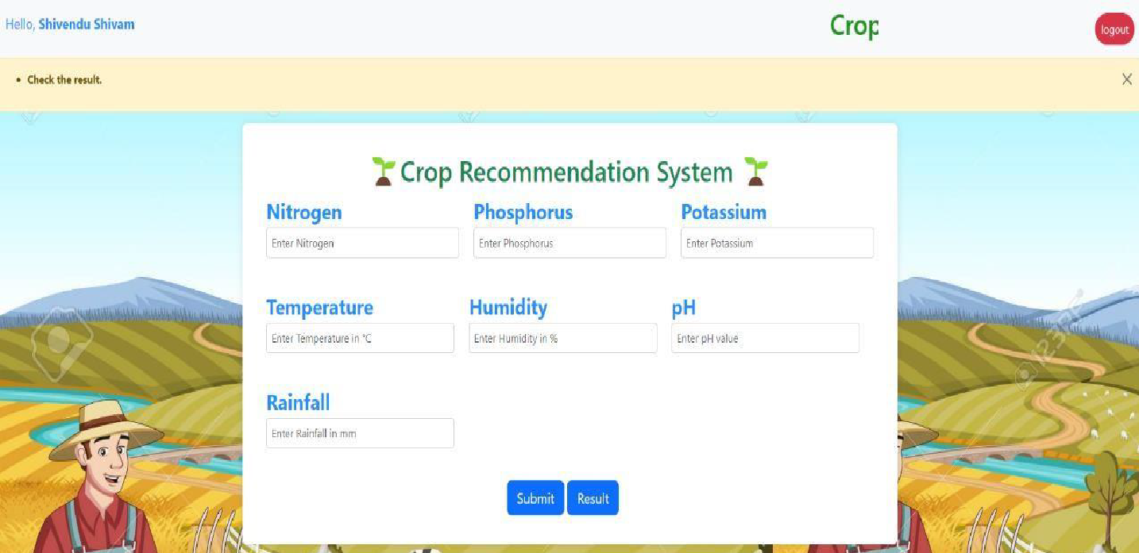
GUI Version of Crop Recommendation System (Main page)

Slide 31
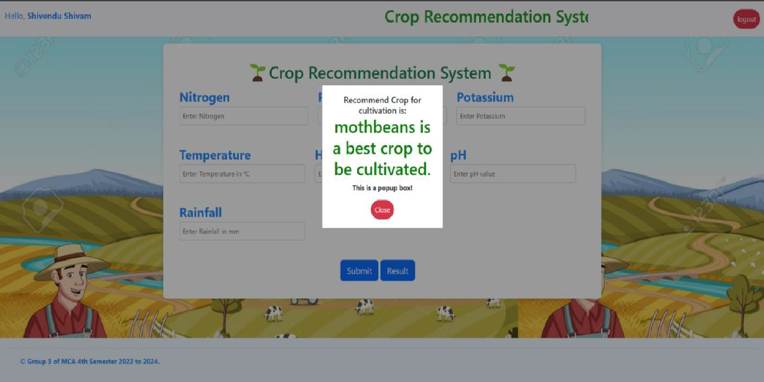
GUI Version of Crop Recommendation System (Main page with result popup)

Slide 32
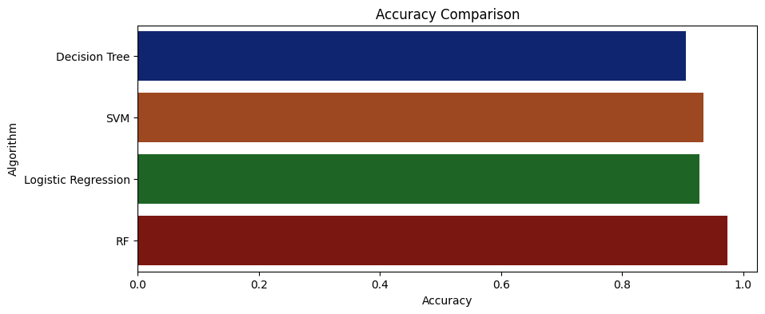
Accuracy comparison graph
Models | Accuracy %
Decision Tree | 90%
Logistic Regression | 92%
Random Forest | 97%
SVM Classifier | 93%
The data shown above is an average of multiple test runs.
We see that the highest accuracy for the train dataset is Random Forest.
So we select Random Forest model to predict the test dataset.

Slide 33
Future advancements in crop recommendation systems could involve integrating real-time data from IoT devices and satellite imagery, enhancing predictive algorithms with deep learning techniques, and personalizing recommendations based on individual farmer preferences.
Improvements in user interface design and accessibility, along with the integration of multi-criteria decision-making methods, could further enhance the usability and effectiveness of these systems.
Collaborative platforms for knowledge sharing among farmers and experts, along with extensive field testing and validation, are essential for ensuring the scalability, reliability, and impact of crop recommendation systems in diverse agricultural settings.
By addressing these areas of improvement, crop recommendation systems can better support farmers in making informed decisions, optimizing resource use, and increasing agricultural productivity
Future scope of
improvements

Slide 34
Thank you
Asansol Engineering College
Siddhartha Khawas (khawassiddhartha73@gmail.com)
Subham Chakraborty (csubham981@gmail.com)
Sumit Kumar Choubey (montuking88@gmail.com)
Shivendu Shivam (shivamlkr502@gmail.com)

